Slide 1
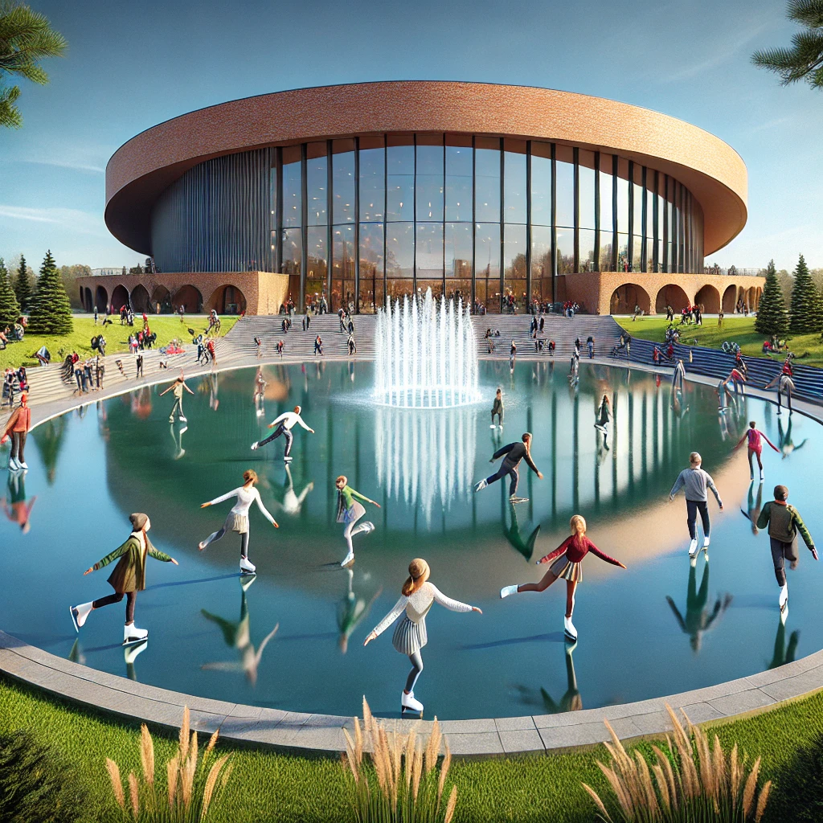

MILLICAN HALL
KNIGHTS ON ICE!
Icy Knights:
Aman Jasani*, Hunter Capelli, Joel Mejia*, Maiya Giarratano, Mauricio Vidal*, Moira Martinous, Tyra Wong-Sang, Ythamarie Rosario*, Reyvan Demesmin*
*Presenting
Notes:
Intro/Close, slide 2: Rey
Scope Slides 3-4 Raven/Ytha
Stakeholders 5 Aman
WBS 6-7 Joel
Communication Plan 8 Mauricio
slide 9 budget 9 Aman
Contributions 10 (Add Independently)

Slide 2
MILLICAN HALL
Notes:
Intro/Close, slide 2: Rey
Scope Slides 3-4 Raven/Ytha
Stakeholders 5 Aman
WBS 6-7 Joel
Communication Plan 8 Mauricio
slide 9 budget 9 Aman
Contributions 10 (Add Independently)

Slide 3
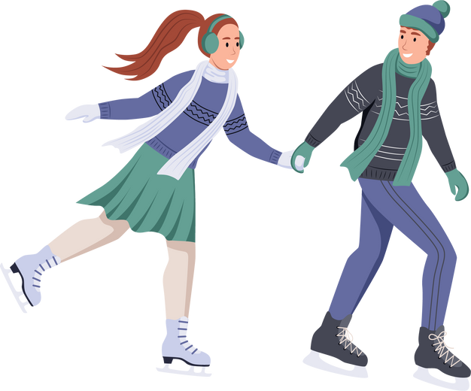


PROJECT PURPOSE
Problem Statement: UCF does not have any events in the winter for its students and alumni. UCF needs to have events for every season to enhance the sense of community and unity on campus. This is why we are proposing an event for winter called “ Knights on Ice”. This event is going to bring holiday fun and develop our institution.
Project Goals: Create a sense of community involvement during the winter/holiday season. Have a successful toy drive to give less fortunate children an opportunity to celebrate
Notes:
Rey:
" good evening fellow knights, do you guys recall what holiday cheer felt like before covid stole holiday cheer of light up ucf?
well no worries, the icy knights are here.. today we promise to thaw the winter chill and warm your hearts with excitement with the iciest tradition yet, "knights on ice"

Slide 4




DELIVERABLES AND FEATURES
not for one religion
no sledding or tubing
a Show like Disney on Ice
Not free (for students or anyone)
VENDOR
(SUPPLY SYNTHETIC ICE, SKATE RENTALS)
OUR VISION
SCREEN PROJECTOR
LOCAL BUSINESS
SPONSORS
Notes:
ytha

Slide 5
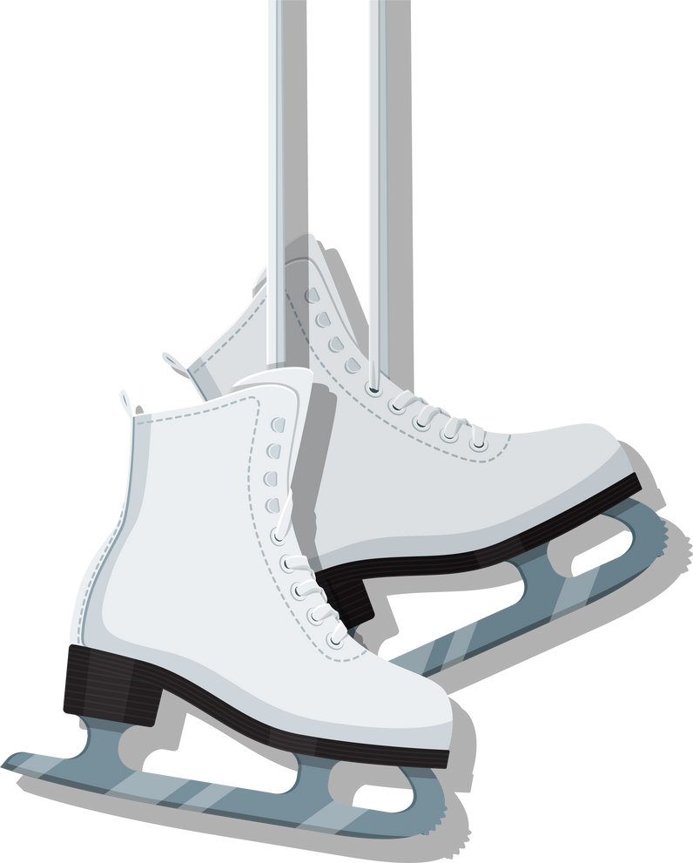


SUCCESS CRITERIA
Ticket Turnout
Money raised for the
College of Business
Number of sponsors
Safety
Reviews
Notes:
ytha

Slide 6


Priorities
Project Priority | Cost | Time | Scope
Priority #1
Priority #2
Priority #3
Notes:
ytha

Slide 7


STAKEHOLDERS
DEAN PAUL JARLEY
EXECUTIVE TEAM AT STUDENT SUCCESS
UCF ALUMNI
STUDENTS
Power: High
Interest: High
Power: MED
Interest: MED
Power: LOW
Interest: MED
Power: High
Interest: MED
Requirement: raising money for the fundraiser
Requirement: increased ticket sales and pride for school
Requirement: volunteer service hours
Requirement: dedicated staff to work event
Write your topic or idea
Write your topic or idea
Write your topic or idea
Write your topic or idea
PROJECT MANAGER & TEAM
LOCAL
BUISNESSES
STUDENT GOVERNMENT
ATTENDEES
Power: LOW
Interest: High
Power: High
Interest: High
Power: MED
Interest: MED
Power: MED Interest: MED
Requirement: increased ticket sales
Requirement: sponsorship of the event
Requirement: enjoyable event worth the ticket price
Requirement: student body involvement
Notes:
aman

Slide 8
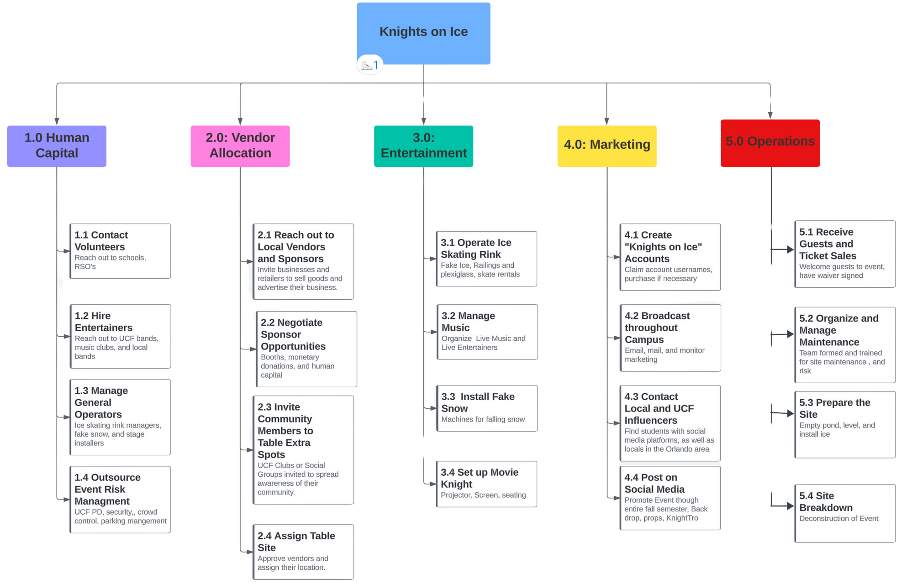
Work Breakdown Structure
Notes:
Joel
Thank you Aman
" Here we have the work-break down structure that breaks all the levels and tasks of the project
Our work breakdown goes by five phases:
1.0: " We have human capital: where we will contact volunteers and hire entertainers.
2.0: " We have vendor allocation: where we reach out to local vendors and negotiate sponsor opportunities
3.0: " We have entertainment: We will manage the music and set up the movie knight
4.0: " We have Marketing: where we will create our "knights on ice" social media
5.0: " Lastly we have operations: we will handle ticket sales and manage maintenance

Slide 9
WORK BREAKDOWN STRUCTURE DICTIONARY
Task ID | Task Title: | Description
1.1: | Contact Volunteers | Reach out to Student Government Assocation, UCF Alumni and partner with local high schools
1.2: | Hire Entertainers | Contact UCF student bands and UCF band director.
1.3 | Manage General Operators | Create a contact list and staff scheduler
1.4: | Outsource Event Risk Management | Partner with UCF Police to work event, create a safety plan Vendor Allocation
2.1: | Reach out to local vendors and sponsors | Contact ice cream shops and student owned businesses
2.2: | Negotiate Sponsor Opportunities | Develop sponsorships with our Suppliers and Vendors by highlighting their brands in our marketing
2.3: | Invite Community Members | Invite local artisans as vendors
Notes:
1.0: For Human Capital: When we contact volunteers we will reach out to Student Government Association
2.0: For Vendor Allocation: When we reach out to local vendors we had the ice cream shop scoops in mind

Slide 10
2.4 | Assign Table Site | Create table arrangement with our premium sponsors being at the forefront
3.1 | Operate Ice Skating Rink | Maintain ice rink, skates, and safety gear
3.2 | Manage Music | Set up nights with different genres and acts
3.3 | Install Fake Snow | Install snow machines and place fake snow
3.4 | Set up Movie Knight | Borrow SGA projector and movie screen
4.1 | Create “Knights on Ice” Accounts | Build all the social media platforms (Tik Tok, Instagram, Facebook, X, etc.) for Knights on Ice.
4.2: | Broadcast Throughout Campus | Put out promotion flyers on monitors in UCF buildings, tabling, and physical flyers in dorms and offices.
4.3: | Contact Local and UCF Influencers | Find UCF students and local Orlando residents who have a large social media presence/platform, to promote Knights on Ice, and invite them to the event to show it off to bring more guests in.
Notes:
3.0: For Entertainment: When we manage music we will set-up different nights with music genres
4.0: For Marketing: When we set up the social media accounts that will include Tik Tok, Facebook, Instagram etc

Slide 11
4.4: | Post on Social Media | Use the Knights on Ice social media platforms to post 2 times weekly with updates on the event, as well as any information attendees would need to know.
5.1: | Receive Guests and Manage Ticket Sales | Create an online ticketing platform for purchasing and allows us to manage the analytics and trends in ticket sales.
5.2: | Organize and Manage Maintenance | Bring in the ice management team, grounds keepers, and first aid and safety crews, and manage them throughout the event.
5.3: | Prepare the Site: Drain | Drain The Reflection Pond of water, level it, and add in the synthetic ice, as well as mark out the vendor spots, put up the stage for live music, photo op spots, and movie night area.
5.4: | Site Breakdown | Work with all vendors and staff to close the event and return The Reflection Pond back to normal after the event.
Notes:
5.0: For Operations: We will manage daily maintenance of the ice rink until the event ends

Slide 12
COMMUNICATION PLAN
Information Type | Timing and/or Frequency | Sender | Receiver | Method of Communication
Icy Knights Newsletter | Weekly | Project Manager | All Stakeholders | Email
Social Media Posts | 3 times a week | Marketing Director | All Stakeholders | Instagram, X, Facebook, Tik Tok
Project Updates | Weekly, increasing as event approaches | Project Coordinator | All Stakeholders | Emails and Texts
Surveys | Monthly | Marketing Director | Potential Attendees | Email and Text
Notes:
mauricio

Slide 13
BUDGET
Total Budget: $293,100
Item | Cost | Description
Ice Rink + Skate rentals | $172,500 | Synthetic ice rink, 120' by 180' provided by skateanytime
Ice rink installation | $100,000 | Permits and design, Professional Labor, Infrastructure, Safety Features, Teardown
Decor | $2000 + UCF Events Department | Tablecloths, Holiday decor, Fake snow, Lights, misc. Purchased through Amazon or borrowed from UCF Events Department
Entertainment | $5000 | Combination of professional entertainers and UCF Volunteers (Live entertainers, A/v Club for movies, etc)
Transport/logistics | $500 | Trucks provided by uhaul, Handled by volunteers
Emergency Services | $9,600 | $50/Hour per officer and EMT 2 Officers and 2 emts provided by UCF PD 48 hours of service
Marketing | 500$ | Posters, Flyers, Print outs Design and DIGITAL marketing provided by UCF Event volunteers
Insurance | $3000 | Sports Event insurance Provided by Eventsured.com

Slide 14

Let’s go Skating
Knights on Ice will become an annual Holiday weekend event Thursday-Sunday creating memories with alumni knights, student body and local businesses
Dean Paul Jarley and the our Project management team are the highest stakeholders
The reflection pond is the main attraction for “knights on ice!”
Our budget is $293,100
Notes:
rey: in conclusion we are very excited to embrace the spirt of togetherness and joy that knights on ice will bring to our community.

Slide 15
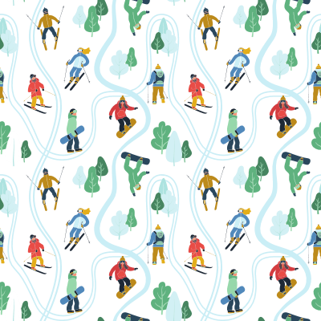
THANK YOU
Any Questions?

Slide 16
Section: B001
TEAM NAME: Icy Knights | % CONTRIBUTED | MEMBER WRITTEN CONTRIBUTIONS
Reyvan | 14% | CREATED SLIDES 1-6&9
Hunter | 7.5% | Built communication Plan, contributed to Dictionary & WBS
Maiya | 7.5% | Triple Constraint
Moira | 7.5% | Set up teams group, Redesigned slide formatting, added and removed distracting elements, integrated animations, and transferred to powerpoint file.
Tyra | 7.5% | Contributed to Stakeholders, success criteria, work breakdown structure, communication plan, & budget.
Ytha | 14% | Redesigned slides 4-6, Presented 4-6
Joel | 14% | Work Breakdown Structure
Mauricio | 14% | presenting Communication plan slide
Aman | 14% | Presenting Stakeholders, Designed and presenting Budget

Slide 17
