Slide 1


Icy Knights Present
KNIGHTS ON ICE
Aman Jasani, Tyra Wong-Sang, Ythamarie Rosario, Hunter Capelli, Reyvan Demesmin, Moira Martinous, Maiya Giarratano, Joel Mejia, Mauricio Vidal
Notes:
The Reflecting Pond at the University of Central Florida is 182 feet by 120 feet at its widest points and is 18 inches to 4 feet deep. It holds an estimated 225,000 to 228,000 gallons of water and is located between Millican Hall and the John C. Hitt Library.

Slide 3



PROJECT SCOPE
Knights on Ice aims to put together a holiday event for the UCF and Orlando community in an effort to raise money for the CBA and host
a toy drive for the children in need of our community.
SCOPE
We will provide ice skating, a holiday market, movie nights,
musical events, and our fundraiser/toy drive for this event.
DEIVERABLE
Notes:
Rey:
" good evening fellow knights, do you guys recall what holiday cheer felt like before covid stole light up ucf?
well no worries, the icy knights are here.. today we promise to thaw the winter chill and warm your hearts with excitement with the iciest tradition yet, "knights on ice"

Slide 4
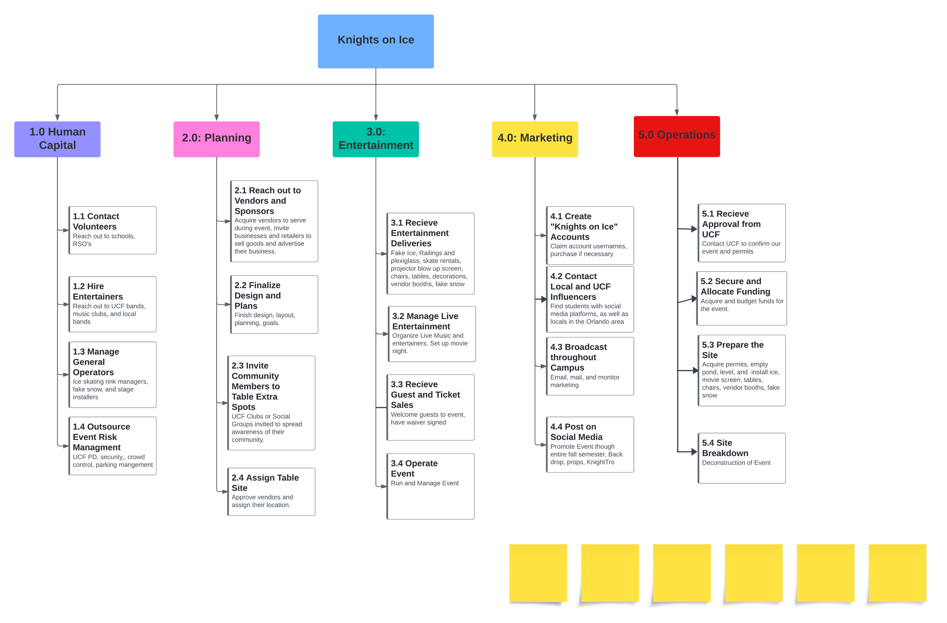
Work Breakdown
Structure
Notes:
joel

Slide 5
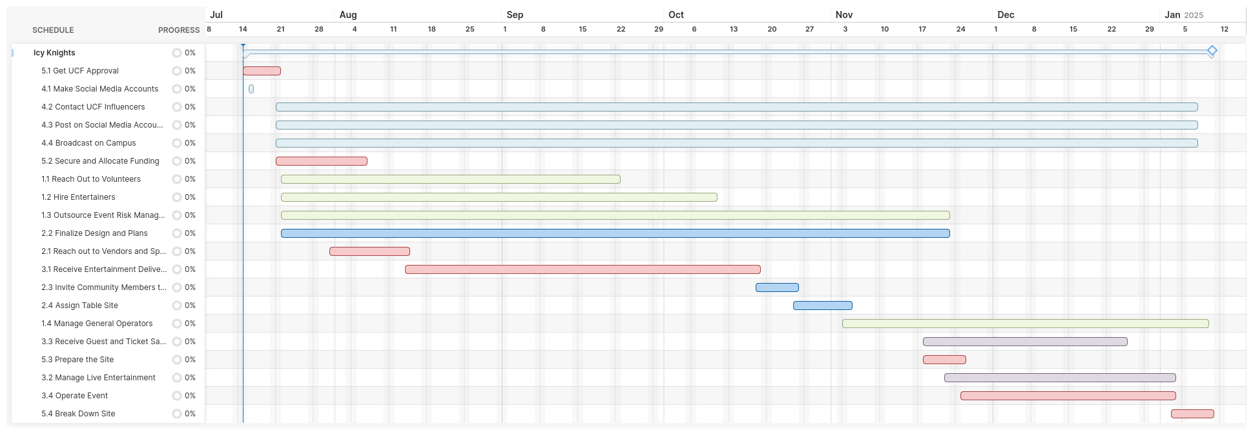

Slide 7
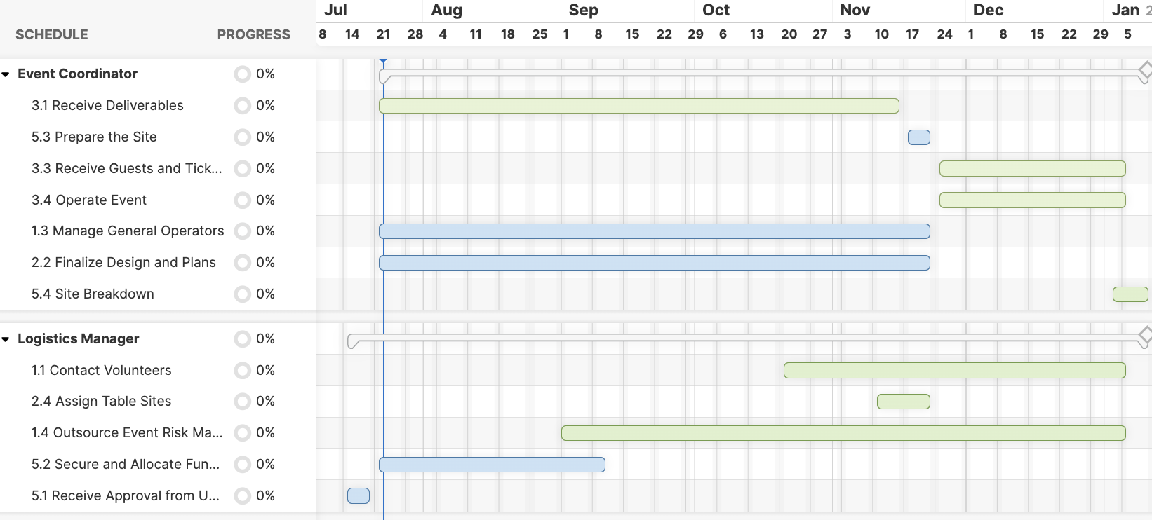
HUMAN RESOURCES CHART

Slide 8
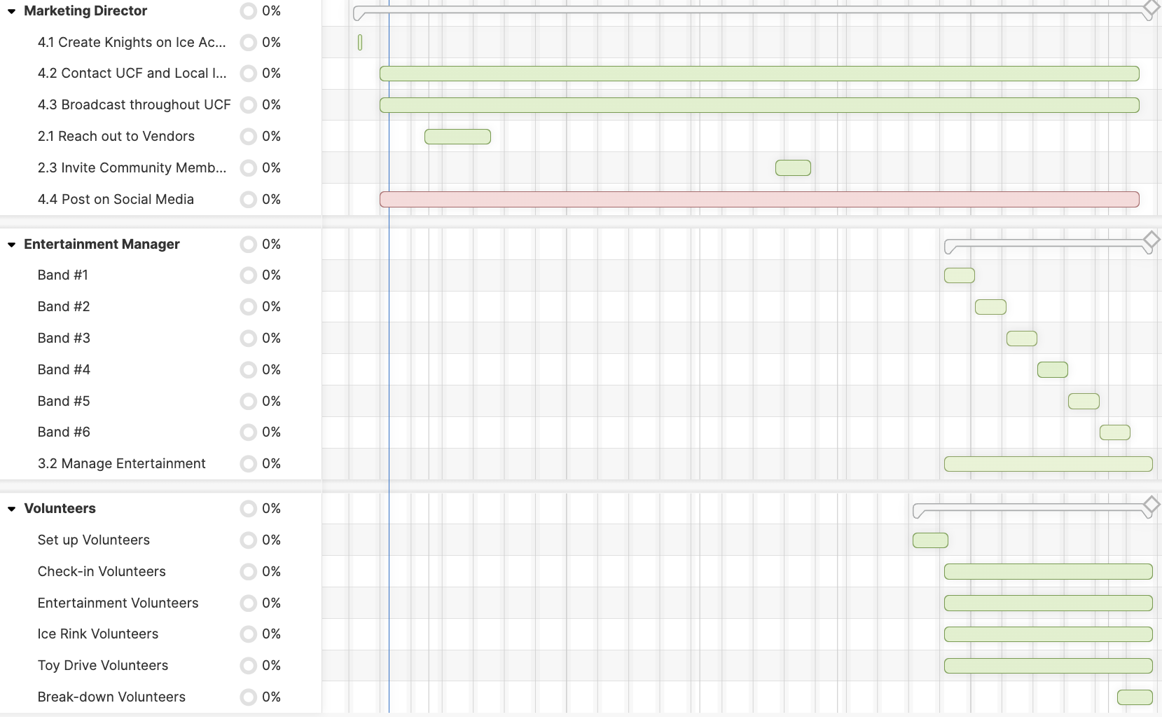
HUMAN RESOURCES CHART

Slide 9
Cumulative Budget
MONTH | ID | Per Project | TOTAL
July | 5.1 | $ - | $ 229,028.33
 | 4.1 | $ 15.09
 | 4.2 | $ 1,666.50
 | 4.3 | $ 9,450.00
 | 4.4 | $ 378.00
 | 5.2 | $ 12,064.08
 | 1.1 | $ 190,000.00
 | 1.2 | $ 4,166.67
 | 1.3 (1) | $ 2,284.67
 | 1.3 (2) | $ 9,003.33
August | 2.1 | $ 1,882.32 | $ 5,948.32
 | 2.2 | $ 4,066.00
September | 1.4 | $ 27,000.00 | $ 27,263.00
 | 2.3 | $ 263.00
October | 3.1 |  | $ -
November | 5.3 | $ 1,583.19 | $ 192,747.65
 | 3.3 | $ 510.00
 | 3.2 | $ 4,167.00
 | 3.1 (1) | $ 174,166.67
 | 3.1 (2) | $ 7,666.33
 | 3.1 (3) | $ 4,331.33
 | 3.4 | $ -
 | 2.4 | $ 323.13
December |  |  | $ -
January | 5.4 | $ 6,794.00 | $ 6,794.00
 |  |  | $ 461,781.31
Notes:
" Thank you Maiya"
Here we have the cumulative budget

Slide 10
MONTH | ID | Itemized | $ Budget
July | 5.1 | $ - | $ 229,028.33
 | 4.1 | $ 15.09
 | 4.2 | $ 1,666.50
 | 4.3 | $ 9,450.00
 | 4.4 | $ 378.00
 | 5.2 | $ 12,064.08
 | 1.1 | $ 190,000.00
 | 1.2 | $ 4,166.67
 | 1.3 (1) | $ 2,284.67
 | 1.3 (2) | $ 9,003.33
August | 2.1 | $ 1,882.32 | $ 5,948.32
 | 2.2 | $ 4,066.00
September | 1.4 | $ 27,000.00 | $ 27,263.00
 | 2.3 | $ 263.00
October | 3.1 |  | $ -
November | 5.3 | $ 1,583.19 | $ 192,747.65
 | 3.3 | $ 510.00
 | 3.2 | $ 4,167.00
 | 3.1 (1) | $ 174,166.67
 | 3.1 (2) | $ 7,666.33
 | 3.1 (3) | $ 4,331.33
 | 3.4 | $ -
 | 2.4 | $ 323.13
December |  |  | $ -
January | 5.4 | $ 6,794.00 | $ 6,794.00
 |  |  | $ 461,781.31
Cumulative Total

Slide 11
CUMULATIVE BUDGET CHARTS

Slide 12

ASSUMPTIONS
ASSUMPTION 1: Most businesses operate Monday through Friday
ASSUMPTION 2: There will be favorable weather conditions during set-up, operation, and breakdown
ASSUMPTION 3: We will receive sufficient budget allocation
ASSUMPTION 4: The installation of the plastic ice will be smooth and all measurements are accurate
ASSUMPTION 5: There will not be any labor or plastic ice shortages during the busy holiday season
ASSUMPTION 6 : The UCF surrounding community members will be willing to attend a paid event
ASSUMPTION 7: Continuing increase of university students attendance even though its holiday break so there is no classes
ASSUMPTION 8: Dean Jarley will attend our event and show support for the fundraising effort for COB
ASSUMPTION 9: Workers will be willing to accept the budgeted pay
ASSUMPTION 10: All cost in the budget will be paid upfront

Slide 13

Conclusion
Knights on Ice will be executed using a waterfall style project management approach, built upon itself from the ground up by an experienced and dedicated team who is excited to bring holiday cheer to the UCF community. We will have several tasks and challenges throughout the months leading to our event, and are prepared to navigate through them thanks to our expert project managers.
Notes:
rey: in conclusion we are very excited to embrace the spirt of togetherness and joy that knights on ice will bring to our community.

Slide 14

THANK YOU
Any Questions?

Slide 15
Team Name: | IcyKnights
Section Number: | B001
Team Member Names | Team Member Contribution
Aman Jasani | Contributed to Budget Quotes, Budget Document, Budget Schedule
Tyra Wong-Sang | Presented, Project Leader, Started PowerPoint, Budget, Assumptions
Ythamarie Rosario | budget quotes 4.3 & 4.4
Hunter Capelli | Presented, Human Resources Chart, Budget
Reyvan Demesmin | Presented, budget quotes, created assumptions for slide 10, collaborated on monthly budget sheet
Moira Martinous | Contributed to multiple budget quotes, created monthly budgeting sheet + charts from it
Maiya Giarratano | Presented, Human Resources Chart, Budget
Joel Mejia | Presented, budget quotes, added to budget sheet
Mauricio Vidal | multiple budget quotes, collaborated on budget sheet

