Slide 1
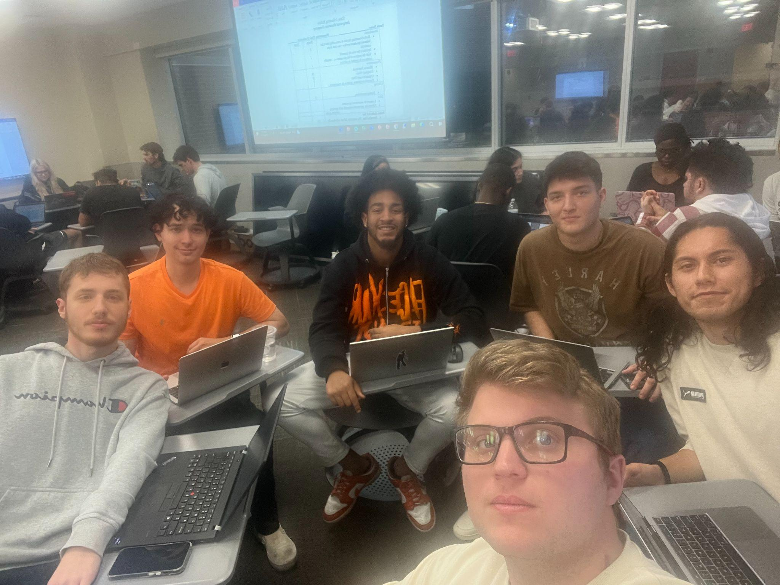
FLOW BTTR
Sales Team #6
Identifying our Target Market
Nicholas Frasca, Jeffrey Estrada, Kaeden Fuller, Steve Gomez, Ajax Jackson, Joel Mejia
Notes:
Nick

Slide 2
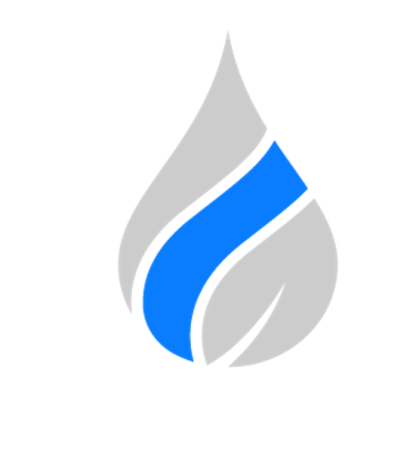
Table of Contents
Walt Disney World Resort in Florida was the most visited vacation resort in the world, attracting over 58 million guests annually.
Company Product: Water Filtration system
Target Industry: Restaurant industry
Target Market: Full service restaurants
Target Market Location: Reedy Creek
Potential Prospects: Paddywagon Irish pub, Wreckers Sports bar, Hattie's tap & Tavern
Notes:
Kaeden

Slide 3
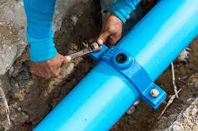
Company Product and Service
FLOW BTTR
Notes:
Kaeden

Slide 4
Target Industry
Target Industry: Restaurant
Type of Company: Full service restaurants
NAICS code: 722511
Notes:
Steve

Slide 5
Target Market
Tourist heavy area with many families
Size - Large market/diverse range of establishments
Menu and Beverage Quality - water quality standards/ regulations
Notes:
Steve

Slide 6
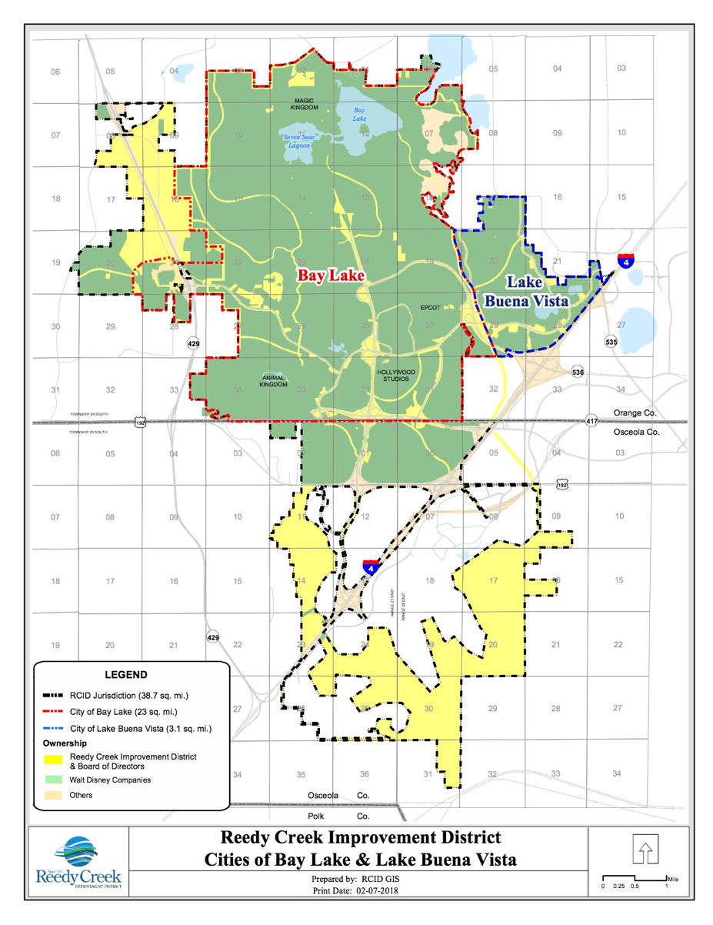
Target Location
Reedy Creek
Mouse zone around reedy creek
in central florida
Central Florida businesses
Median Income: 117,052.58
Population in the area 2023: 22,518
Notes:
Ajax

Slide 7
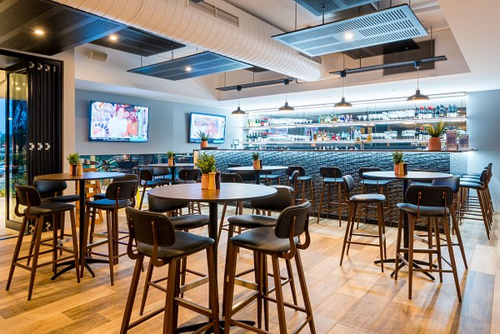
Potential Prospect #1
Paddywagon Irish Pub Lake Buena Vista
Sales Volume: $130,609 per month
Established: 2017
currently has 2 location central florida
Lake buena vista and Dr Phillips
Notes:
Jeffrey

Slide 8
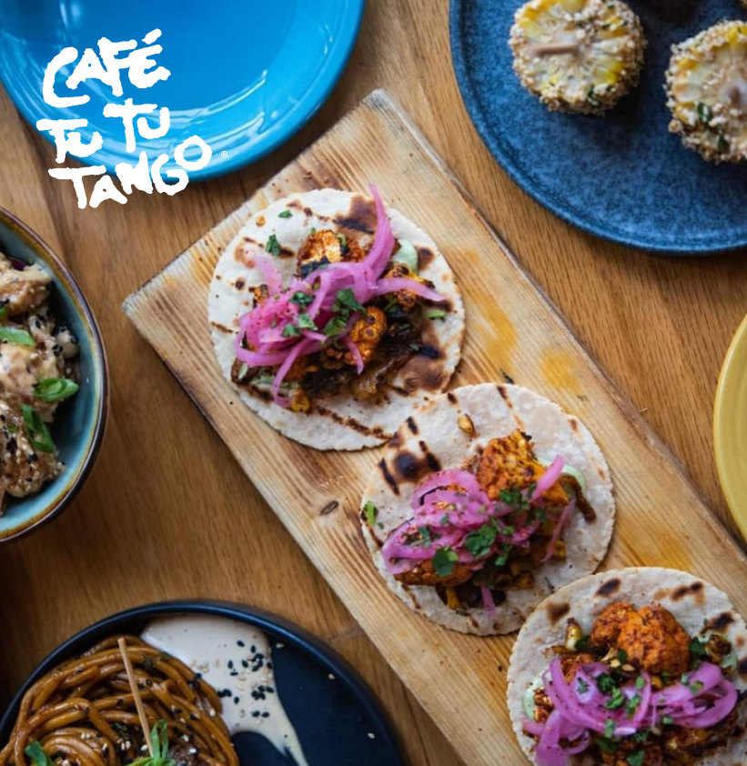
Potential
Prospect #2
Cafe Tu Tu Tango
Highly rated on multiple trip
advisor websites for restaurants
around disney
Popular spanish restaurant for locals
and travelers
Notes:
Jeffrey

Slide 9
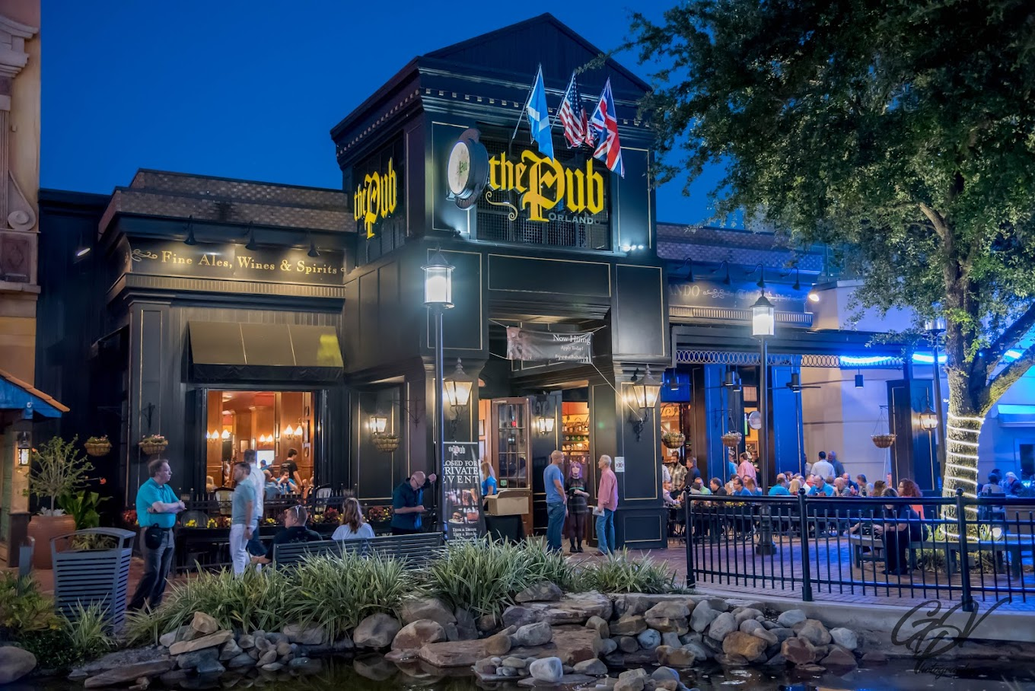
Potential Prospect #3
The Pub on International Drive
Sales Volume: $ 575,000 per month
Opened every day, 13 hours a day
Notes:
Joel
Thank you Jeffrey
For our last prospect we are looking at The Pub on International Dr.
With an outstanding sales volume of $ 575,00 per month
and 13 hours of service daily,
We will definitely help them save a lot of money
I will now pass it on to Steve for the conclusion

Slide 10
Conclusion
Targeting the restaurant industry
The reedy creek area has a lot of traction being where disney is
Small businesses can utilize the savings from their water bill to put into other parts of the business
Notes:
Steve

Slide 11
References
Published by Statista Research Department, & 27, A. (2023, April 27). Global Food Service Market Size 2028. Statista. https://www.statista.com/statistics/1095667/global-food-service-market-size/#:~:text=The%20size%20of%20the%20global,percent%20from%202021%20to%202028.
Solutions 06/01/2021, P. W. (2021, June 1). The benefits of cooking with filtered water. Pentair Water Solutions. https://www.pentair.com/en-us/water-softening-filtration/blog/benefits-of-cooking-with-filtered-water.html#:~:text=One%20often%2Doverlooked%20component%20of,foods%20and%20drinks%20we%20consume.
Notes:
Steve

