Slide 1
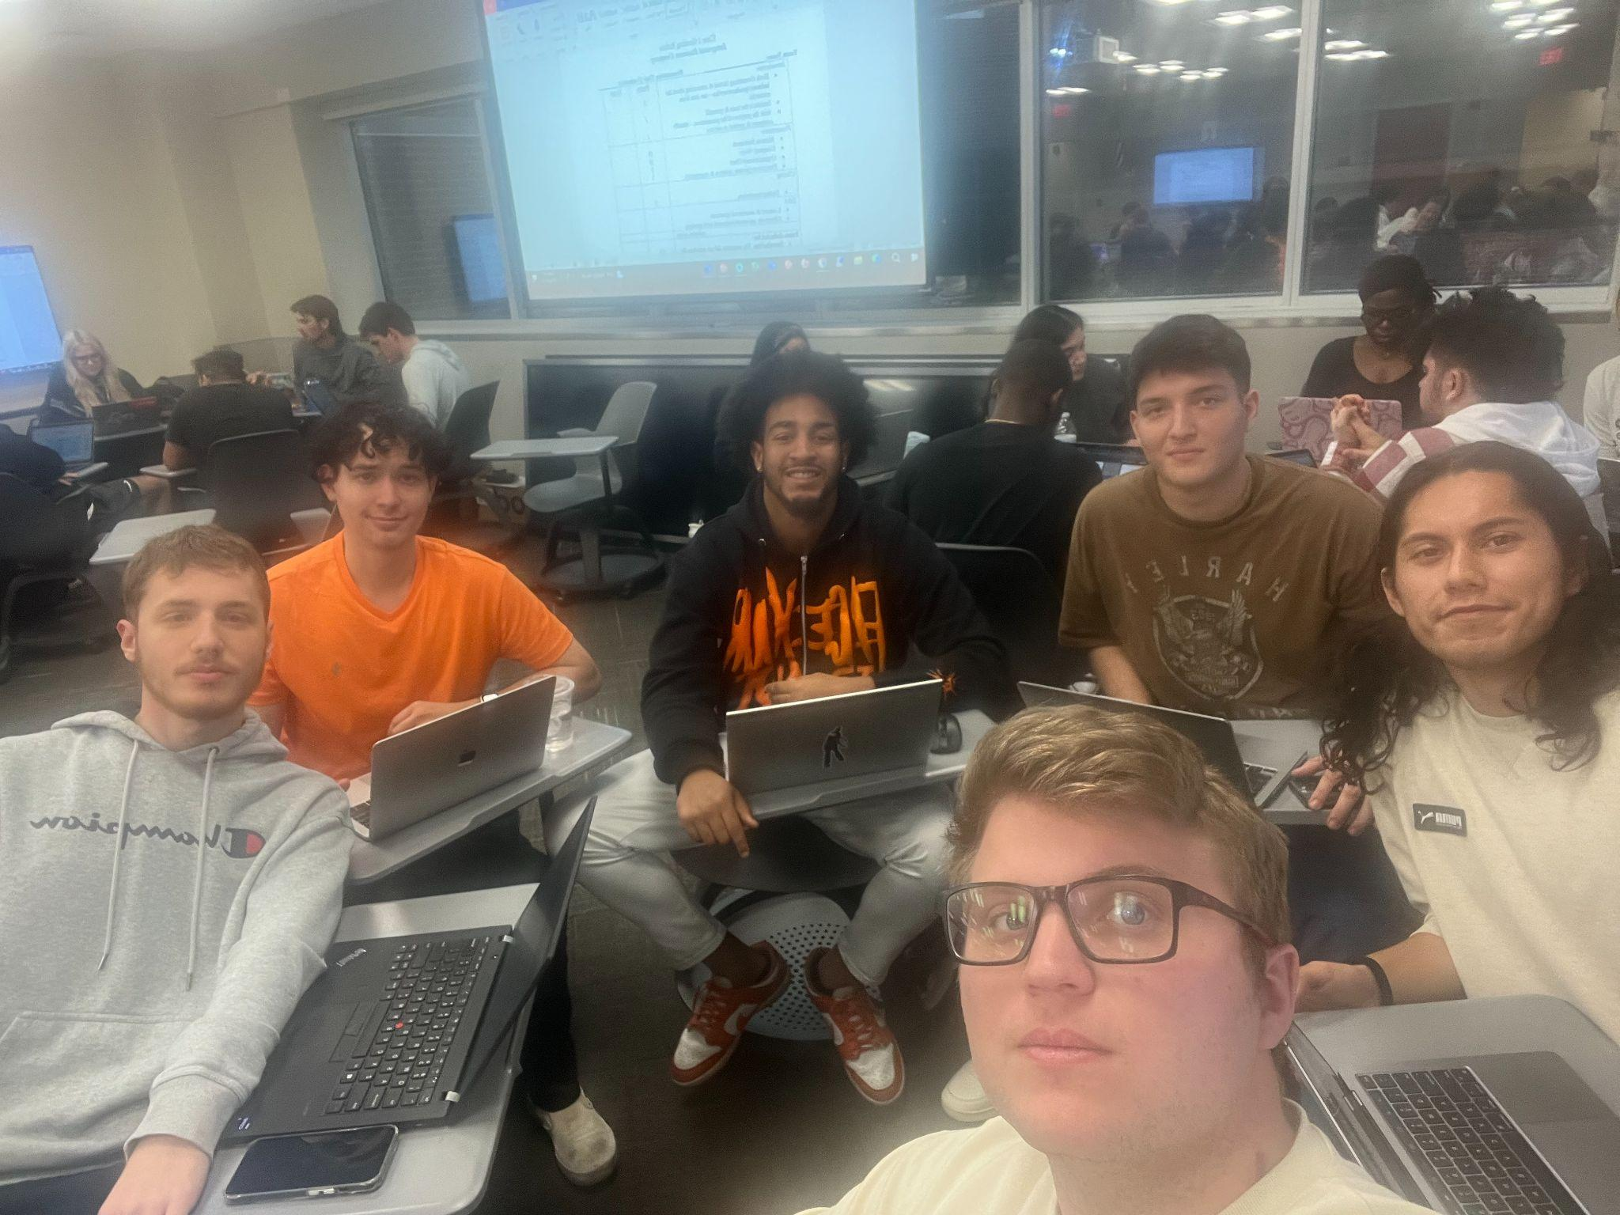
FLOW BTTR
Sales Team #6
Team Members: Nicholas Frasca, Kaeden Fuller, Steve Gomez, Jeffery Estrada, Joel Mejia, Ajax Jackson
Notes:
Ajax

Slide 2
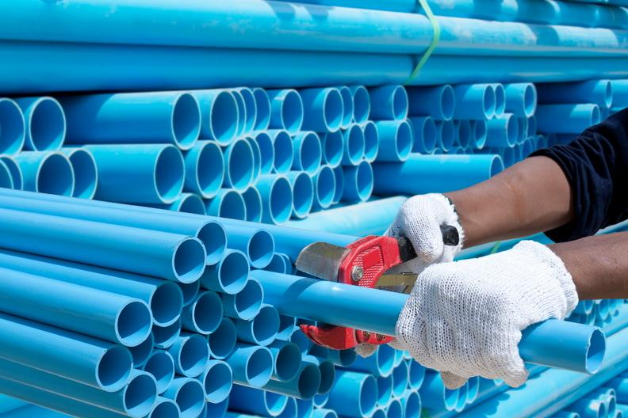
Table of Contents
Company Product and Service
Mission Statement
Company Background
Organizational Chart
Professional Background
Conclusion
References
Notes:
Ajax

Slide 3
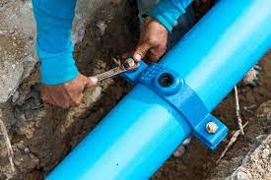
Company Product and Service
FLOW BTTR
Product Features
Decreases water waste
Improves quality of water
Reduces number of water leaks
More accurately measures the amount of water flow
Notes:
Steve

Slide 4
Mission Statement
“The restaurant industry is filled with mismanagement of water. The industry standard is 24 gallons per seat
and FLOW BTTR is on a mission to bring that down and help small businesses save money”
What do you do?: Provide businesses with a water filter that will save their business money as well as reduce
contaminants in the water.
How do you do it?: Will professionally install the water filters into your water system.
Whom we do it for: Restaurants that are looking to save money on their water
Bill & improve the quality of their water pipes
The value we offer: The opportunity to save money on their water bill, reduce the contaminants
in their water, and preventing leaks thus extending the life of a businesses
plumbing system.
Notes:
Nicholas

Slide 5
Company Background
When: Flow Bttr was founded in August of 2020
Where: Flow Bttr was brought to fruition in the bustling city of Miami, Florida.
Who: A group of UCF alumni who saw an opportunity, and vacancy for a spot waiting to be filled.
Why: We saw first hand how much restaurants spend on water, as well as how much they need to ensure the water they provide is up to regulation.
Notes:
Kaeden

Slide 6
Notes:
Joel:
Thank you Kaedon
Here we have the Organization Chart:
We have Kaeden at the top as CEO
Myself as Head of Marketing with Ajax as my sales Associate
Jeffrey as Head of Product Development with Steve as the project engineer
Lastly Nick as Head of Services and Installations
Next we are going to talk about our profession background

Slide 7
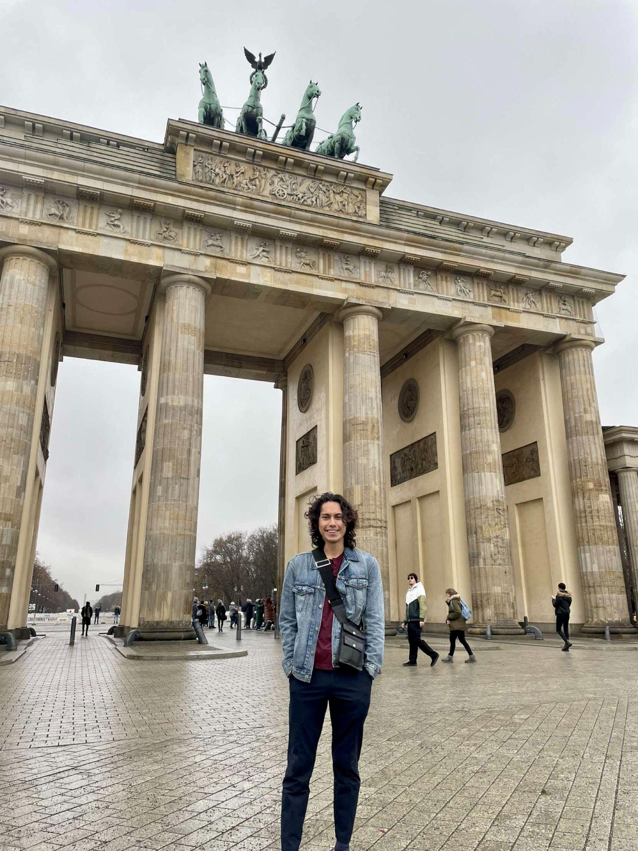
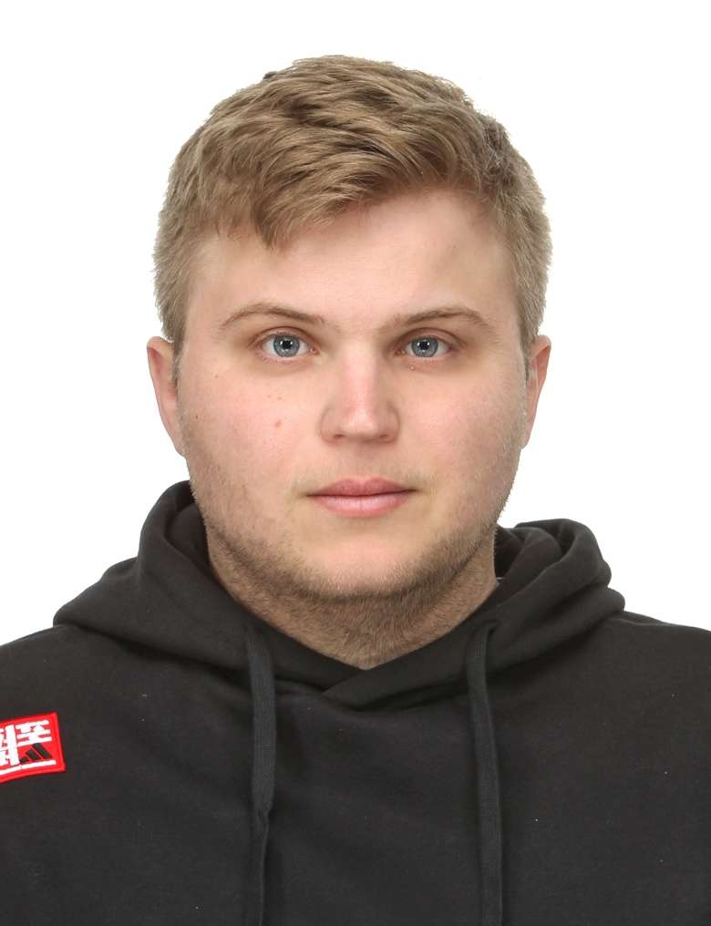
Professional Background
Ajax is a Sales associate with Flow BTTR focused on selling quality products and services to local Florida businesses. With 2 years of sales experiences in CFL and a bachelors from the University of Central Florida, Ajax is equipped the with skills to bring our quality products to lower the costs of running a business in our local area
Meet Jeffery Estrada Originating from Orlando Florida . A UCF alumni with 4 years of experience in product development. Dedicated to providing businesses with efficient water consumption with Flow BTTR services and product

Slide 8
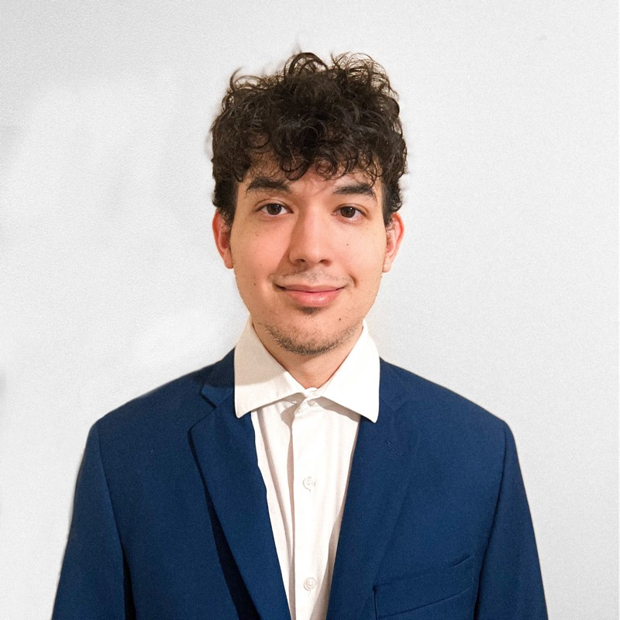
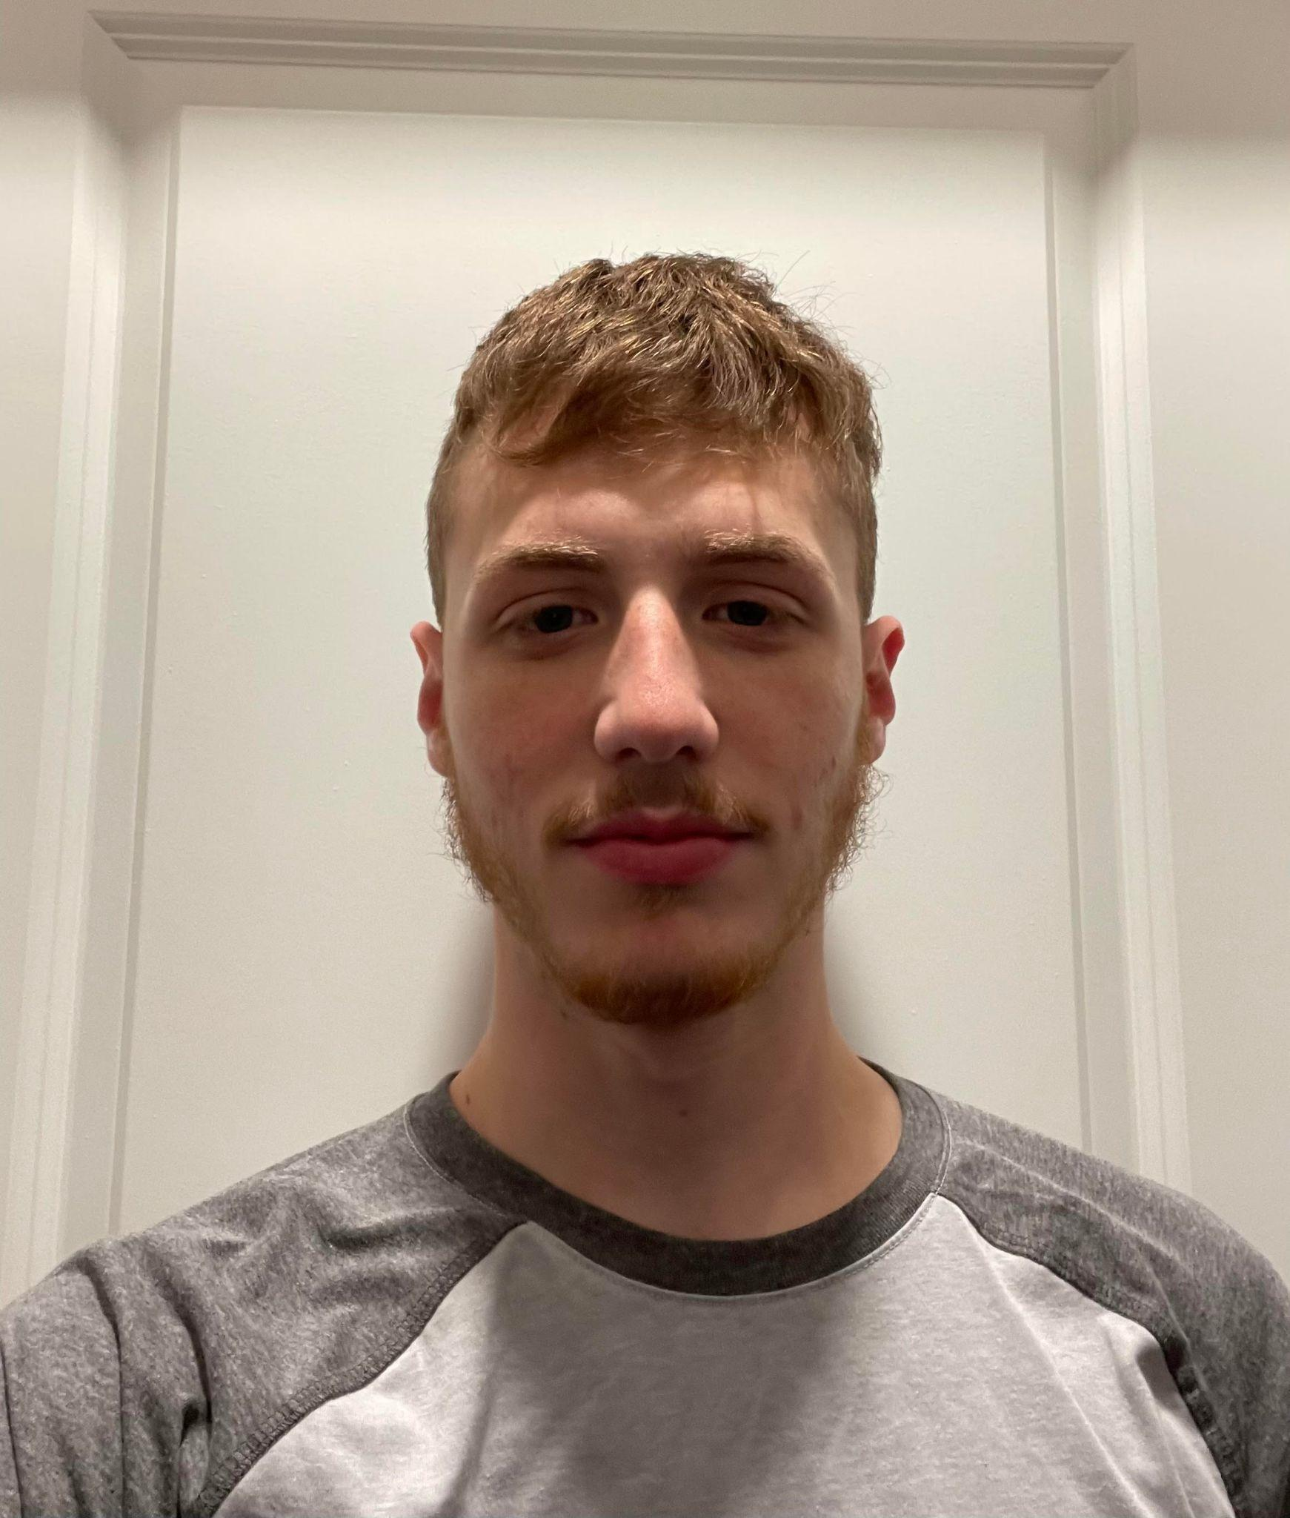
Professional Background
Joel Mejia is the Head of the Marketing Department here at FLOW BTTR. An alumni of the UCF College of Business, Joel has 5 years of experience as a Marketer, and is helping us expand beyond CFL to pursue Southern Florida by the end of the year.
Nicholas Frasca is Head of Services and Installation with 3 years of experience in the water industry. 2 year degree in engineering, and a vocational certificate in plumbing. Equipped with the proper skills to oversee proper installation of water filters, and ensure the highest quality.

Slide 9
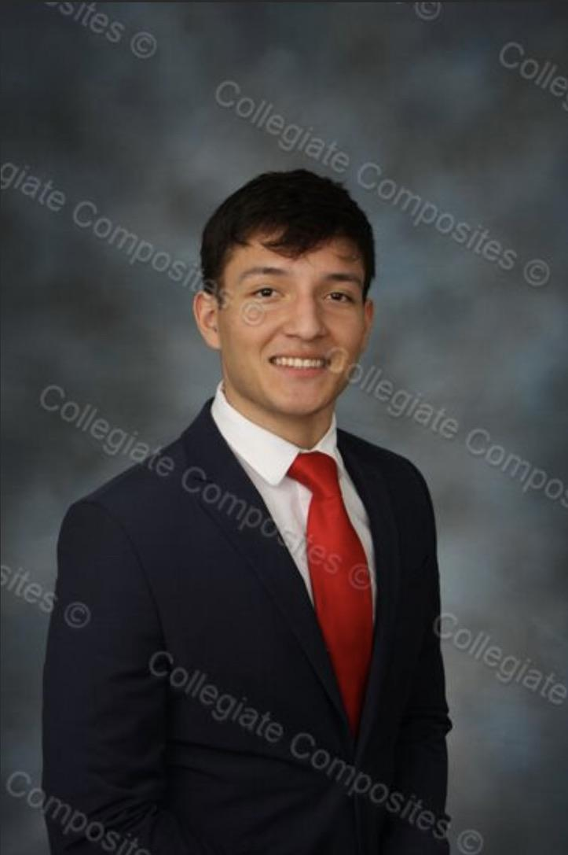
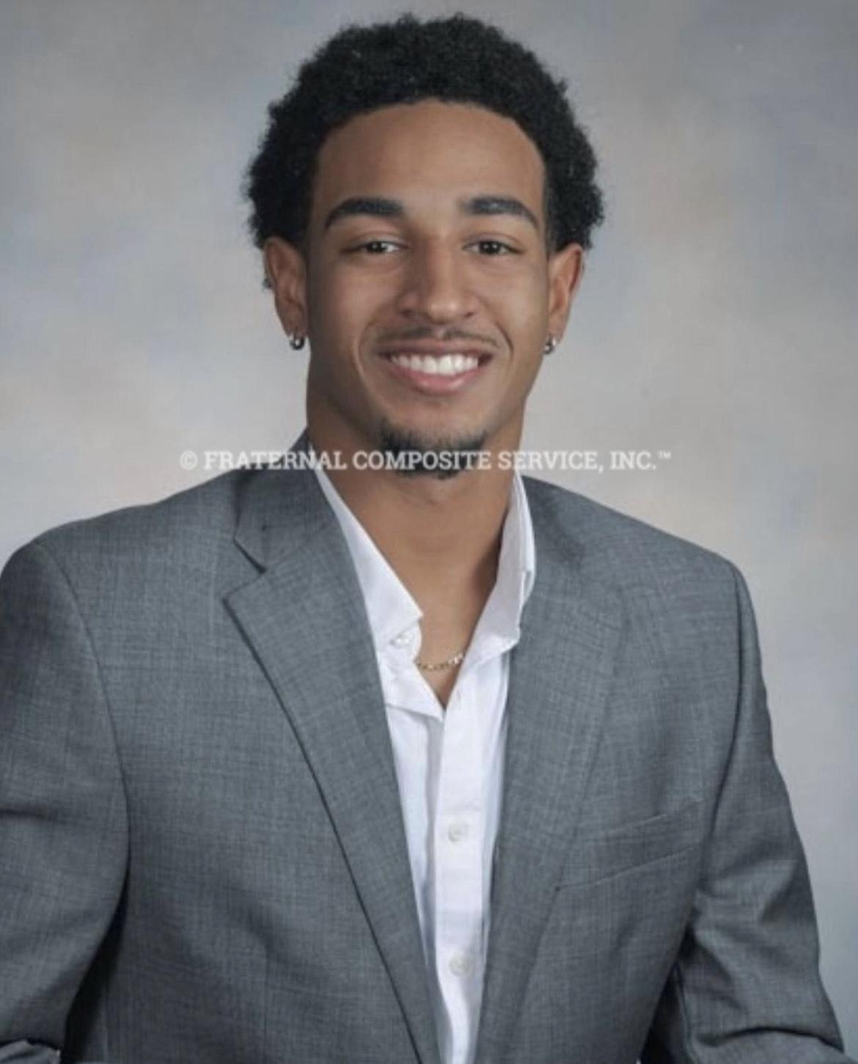
Professional Background
Meet Steve Gomez, a visionary product engineer with 5 years in the water industry, dedicated to revolutionizing water conservation. He specializes in crafting water pipes that exceed the industry standard, ensuring a significant reduction in water waste and higher quality water.
Meet Kaeden Fuller, the forward-thinking CEO at the of ‘FLOW BTTR”, a company which specializes in water-saving solutions. Thanks to his 5 years of management experience, the company has become a driving force in the industry, delivering cutting-edge water filters that set new standards for conservation, and impactful innovation.

Slide 10
Conclusion
FLOW BTTR is a company originating from miami and founded by 6 UCF Alumni striving to increase savings on water bills, provide higher quality water and protect the environment from excess waste.
FLOW BTTR works with small to middle size restaurants by installing newly improved water pipes that lead to less water leaks, in turn reducing waste water that typically leads to pollution and a healthier environment.
Notes:
Jeffrey

Slide 11
References
United Nations. (n.d.). The 17 goals | sustainable development. United Nations. https://sdgs.un.org/goals
Stricklin, T. (2023, September 21). 9 health benefits you didn’t know filtered water provides. SpringWell Water Filtration Systems. https://www.springwellwater.com/9-health-benefits-of-filtered-water/
Puragain Water. (2023, June 12). 10 benefits of home filtered water: Puragain water. Puragain Water | Whole House Water Filtration & Water Softening Systems. https://www.puragainwater.com/10-benefits-of-home-filtered-water/#:~:text=Avoid%20Water%20Contamination&text=If%20your%20water%20supply%20is,bacteria%2C%20and%20hazardous%20biological%20material
Stricklin, T. (2023, February 14). 9 health benefits you didn’t know filtered water provides. SpringWell Water Filtration Systems. https://www.springwellwater.com/9-health-benefits-of-filtered-water/

