Slide 1
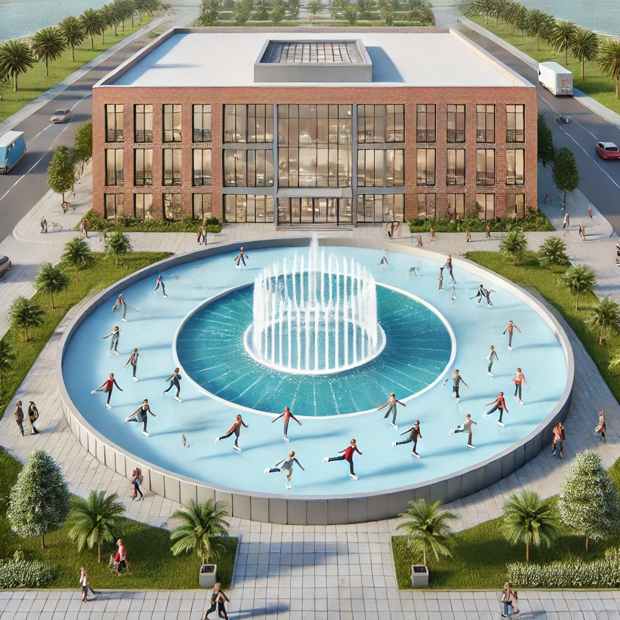
MILLICAN HALL
KNIGHTS ON ICE!
ICY KNIGHTS
*AMAN JASANI, *HUNTER CAPELLI, JOEL MEJIA, *MAIYA GIARRATANO, MAURICIO VIDAL, *MOIRA MARTINOUS, *TYRA WONG-SANG, YTHAMARIE ROSARIO, REYVAN DEMESMIN
Notes:
Intro/Close, slide 2: Rey
Scope Slides 3-4 Raven/Ytha
Stakeholders 5 Aman
WBS 6-7 Joel
Communication Plan 8 Mauricio
slide 9 budget 9 Aman
Contributions 10 (Add Independently)

Slide 2
MILLICAN HALL
KNIGHTS ON ICE!
ICY KNIGHTS
*AMAN JASANI, *HUNTER CAPELLI, JOEL MEJIA, *MAIYA GIARRATANO, MAURICIO VIDAL, *MOIRA MARTINOUS, *TYRA WONG-SANG, YTHAMARIE ROSARIO, REYVAN DEMESMIN
Notes:
Intro/Close, slide 2: Rey
Scope Slides 3-4 Raven/Ytha
Stakeholders 5 Aman
WBS 6-7 Joel
Communication Plan 8 Mauricio
slide 9 budget 9 Aman
Contributions 10 (Add Independently)

Slide 3
MILLICAN HALL
MILLICAN HALL
Notes:
Intro/Close, slide 2: Rey
Scope Slides 3-4 Raven/Ytha
Stakeholders 5 Aman
WBS 6-7 Joel
Communication Plan 8 Mauricio
slide 9 budget 9 Aman
Contributions 10 (Add Independently)

Slide 4
PROJECT SCOPE
Knights on Ice aims to put together a holiday event for the UCF and Orlando community to raise money for the CBA and host a toy drive
for the children in need of our community.
SCOPE
We will provide ice skating, a holiday market, movie nights,
musical events, and our fundraiser/toy drive for this event.
DEIVERABLE
Notes:
Rey:
" good evening fellow knights, do you guys recall what holiday cheer felt like before covid stole light up ucf?
well no worries, the icy knights are here.. today we promise to thaw the winter chill and warm your hearts with excitement with the iciest tradition yet, "knights on ice"

Slide 5
Work Breakdown
Structure
Notes:
joel

Slide 6
Duration Estimate
Activity | Estimated Time Duration | Predecessors
1.1 Contact Volunteers | 80 Days Early Start/Finish: 7/87 Late Start/Finish: 14/94 | 5.1
1.2 Hire Entertainers | 80 Days Early Start/Finish: 7/87 Late Start/Finish: 14/94 | 5.2
1.3 Manage General Operators | 51 Days Early Start/Finish: 128/179 Late Start/Finish: 129/180 | 1.2
1.4 Outsource Event Risk Management | 123 Days Early Start/Finish: 7/130 Late Start/Finish: 14/137 | 5.1
2.1 Reach out to Vendors | 15 Days Early Start/Finish: 50/65 Late Start/Finish: 50/65 | 5.2
2.2 Finalize Design and Plans | 123 Days Early Start/Finish: 7/130 Late Start/Finish: 10/133 | 5.1
2.3 Invite Community Members to Table Extra Spots | 7 Days Early Start/Finish: 119/126 Late Start/Finish: 120/127 | 2.1
2.4 Assign Table Sites | 10 Days Early Start/Finish: 126/136 Late Start/Finish: 128/138 | 2.3

Slide 7
Activity | Estimated Time Duration | Predecessors
3.1 Receive Entertainment Deliveries | 65 Days Early Start/Finish: 65/130 Late Start/Finish: 65/130 | 2.1
3.2 Manage Live Entertainment | 37 Days Early Start/Finish: 137/174 Late Start/Finish: 140/177 | 3.1
3.3 Receive Guest and Ticket Sales | 44 Days Early Start/Finish: 130/174 Late Start/Finish: 131/175 | 3.1
3.4 Operate Event | 39 Days Early Start/Finish: 137/176 Late Start/Finish: 137/176 | 5.3
4.1 Create “Knights on Ice” Accounts | 1 Day Early Start/Finish: 1/2 Late Start/Finish: 7/8 | 5.1
4.2 Contact Local and UCF Influencers | 174 Days Early Start/Finish: 2/176 Late Start/Finish: 5/179 | 4.1
4.3 Broadcast Through Campus | 174 Days Early Start/Finish: 2/176 Late Start/Finish: 5/179 | 4.1

Slide 8
Activity | Estimated Time Duration | Predecessors
4.4 Post on Social Media | 174 Days Early Start/Finish: 2/176 Late Start/Finish: 5/179 | 4.1
5.1 Receive Approval from UCF | 7 Days Early Start/Finish: 0/7 Late Start/Finish: 0/7 | Start
5.2 Secure and Allocate Funding | 43 Days Early Start/Finish: 7/50 Late Start/Finish: 7/50 | 5.1
5.3 Prepare the Site | 7 Days Early Start/Finish: 130/137 Late Start/Finish: 130/137 | 3.1
5.4 Breakdown the Site | 3 Days Early Start/Finish: 176/179 Late Start/Finish: 176/179 | 3.4

Slide 9
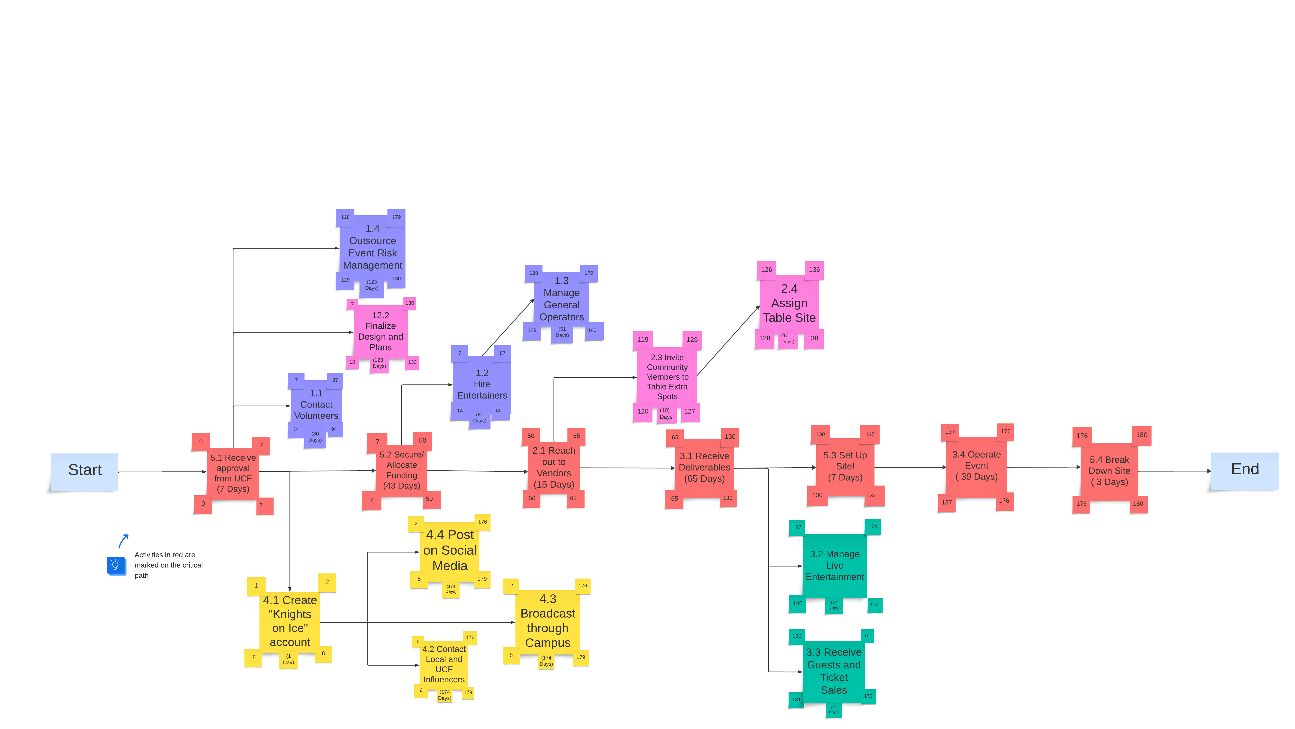
Network Diagram

Slide 10
Network Diagram

Slide 11
Network
Diagram

Slide 14
ASSUMPTIONS
ASSUMPTION 1: Business operations will be Monday through Friday, while event operations are 7 days a week (work schedules).
ASSUMPTION 2: There will be favorable weather conditions during set-up, operation, and breakdown.
ASSUMPTION 3: We will receive sufficient budget allocation to fund all event operations.
Notes:
Rey:
" good evening fellow knights, do you guys recall what holiday cheer felt like before covid stole light up ucf?
well no worries, the icy knights are here.. today we promise to thaw the winter chill and warm your hearts with excitement with the iciest tradition yet, "knights on ice"

Slide 15
Conclusion
Knights on Ice will be executed using a waterfall style project management approach, built upon itself from the ground up by an experienced and dedicated team who is excited to bring holiday cheer to the UCF community. We will have several tasks and challenges throughout the months leading to our event, and are prepared to navigate through them thanks to our expert project managers.
Notes:
rey: in conclusion we are very excited to embrace the spirt of togetherness and joy that knights on ice will bring to our community.

Slide 16
THANK YOU
Any Questions?

Slide 17
TEAM NAME: Icy Knights​ | % CONTRIBUTED​
Reyvan​ | 7.5%​
Hunter​ | 14%​
Maiya​ | 14%​
Moira​ | 14%​​
Tyra​ | 14%​
Ytha​ | 7.5 %
Joel​ | 7.5%​
Mauricio​ | 7.5%​
Aman​ | 14%​

